Slide 1
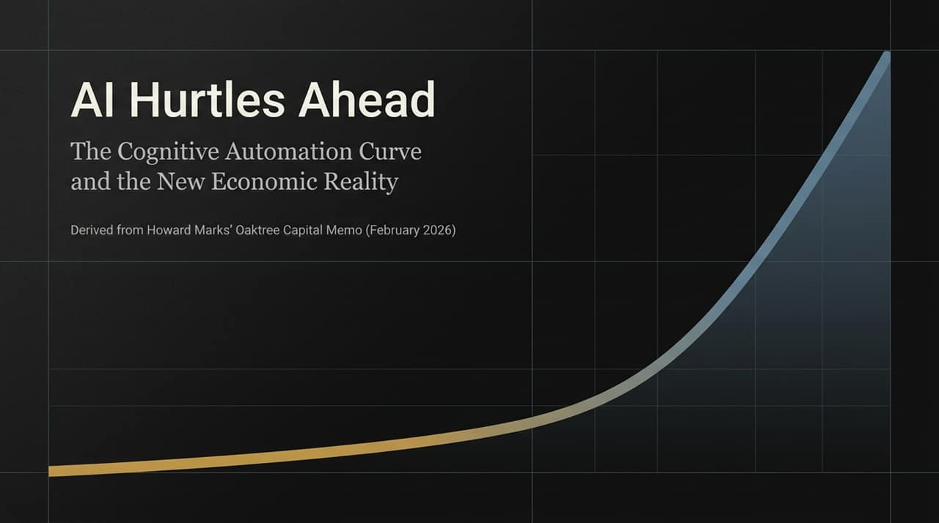
Notes:
https://www.oaktreecapital.com/insights/memo/ai-hurtles-ahead
Opening Framing: Welcome everyone. Today we are looking at how artificial intelligence is moving beyond a productivity tool and fundamentally reshaping investment management, knowledge work, and macroeconomics.
Source Context: This deck synthesizes key frameworks from Howard Marks’ Oaktree Capital memo, "AI Hurtles Ahead".
Core Thesis: The main thesis here is straightforward: AI is not merely optimizing human labor—it is replacing cognitive tasks entirely and compressing decades of technological adoption into a matter of months.
Roadmap: We will examine the cognitive mechanisms behind AI, its speed of adoption, the transition to autonomous agents, the boundaries of machine cognition, and what all of this means for generating investment alpha.

Slide 2
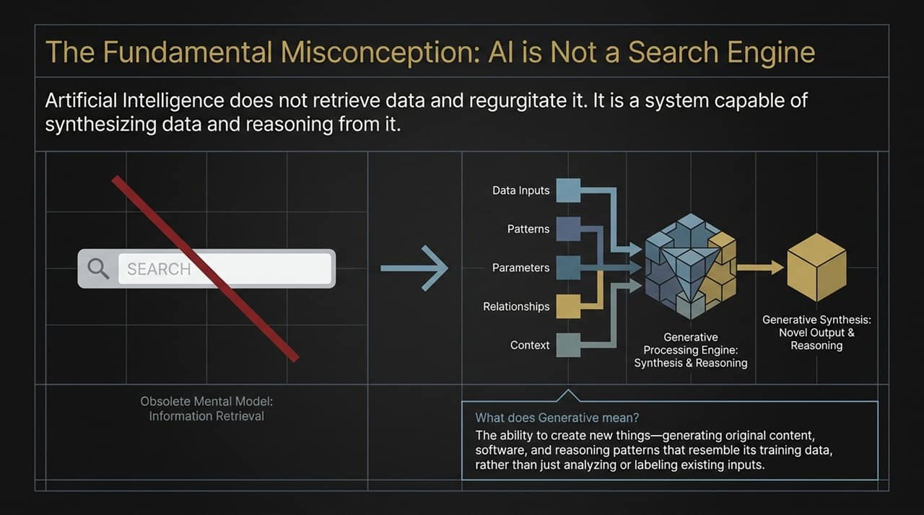
Notes:
Addressing the Misunderstanding: Many people still treat Large Language Models like an upgraded Google search box—a tool that fetches stored data and regurgitates it. That is an obsolete mental model.
Search vs. Generative Processing:
Search/Retrieval: Indexes data and returns existing links or documents based on matching parameters.
Generative AI: Takes input parameters, identifies underlying relationships and context, and runs it through a synthesis and reasoning engine to produce novel output.
Defining "Generative": Generative does not mean copying; it means creating original code, structured arguments, or analytical summaries that resemble training data patterns without directly copying them.
Takeaway for the Audience: When evaluating AI’s role in business, do not ask "What database can it search?" Ask "What analytical synthesis can it perform?"

Slide 3
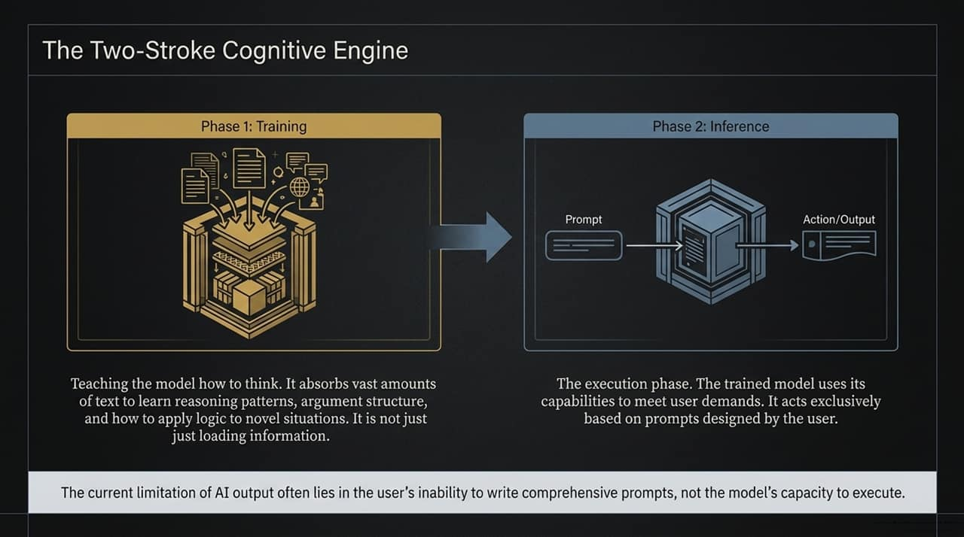
Notes:
Phase 1 — Training (Teaching How to Think):
The common misconception is that training is simply "loading facts" into a database.
As Howard Marks points out, training is about teaching the model how to think. By ingesting trillions of parameters, it absorbs reasoning patterns, argument structures, and logical frameworks to apply to unseen situations.
Phase 2 — Inference (Execution):
Inference is the operational engine where prompts trigger action. The model uses its trained reasoning structure to solve the specific request given by the user.
The Bottleneck (Prompt Engineering):
A critical insight from the memo: The current limit on AI output is rarely the capability of the underlying model—it is the user’s inability to write clear, comprehensive prompts.
The better the prompt's instructions and parameters, the closer the output gets to institutional-grade execution.

Slide 4
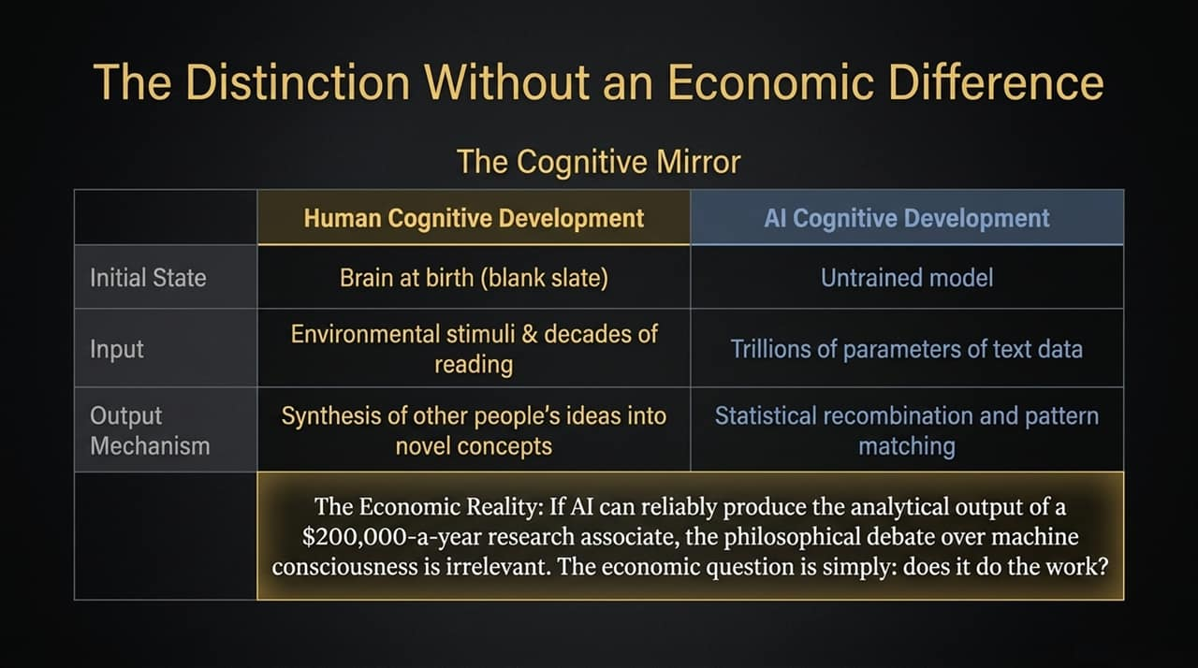
Notes:
The Philosophical vs. Economic Argument:
Skeptics argue that AI isn't "truly conscious" or "really thinking"—it is just statistical pattern matching and next-token prediction.
Comparing Cognitive Development:
Human brains start as blank slates and develop reasoning by absorbing environmental stimuli over decades.
AI starts as an untrained model and develops reasoning capabilities by absorbing trillions of tokens of human text.
The Economic Reality:
From a capital-allocation perspective, the philosophical debate over machine consciousness is irrelevant.
If an AI model can reliably deliver the work product of a $200,000-a-year research associate in seconds for pennies, the market does not care if it is "thinking" or "pattern matching"—it only cares whether the work gets done reliably.

Slide 5
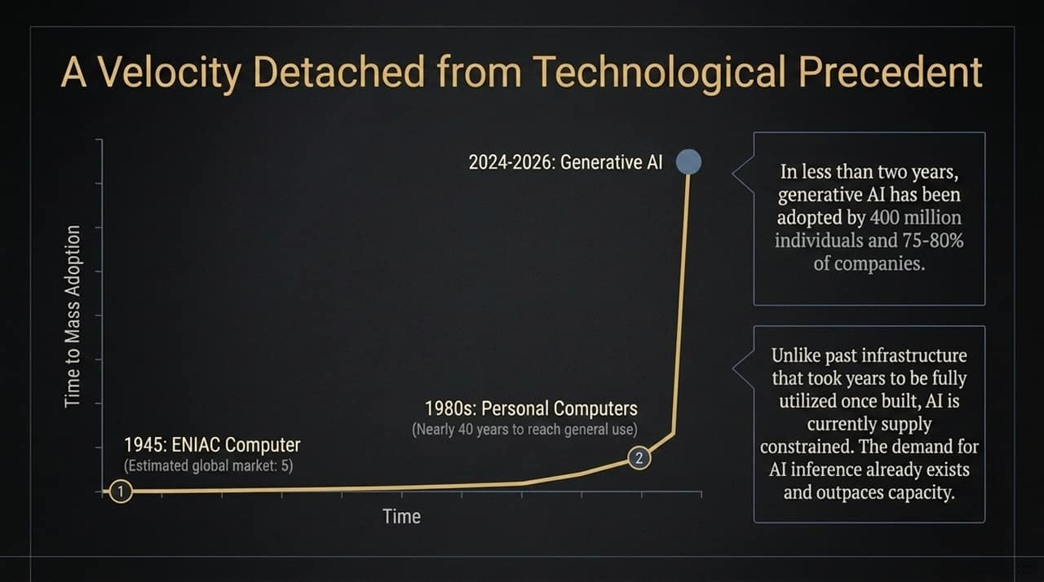
Notes:
Historical Velocity:
The ENIAC computer was built in 1945. It took nearly 40 years—through microprocessors in the 70s—for the IBM PC to bring personal computing to general business and home use in the early 1980s.
The Generative AI Explosion:
In contrast, Generative AI went from early adoption to over 400 million active users and 75–80% corporate penetration in under two years.
Supply vs. Demand Dynamics:
Past technological waves required building physical infrastructure before demand materialized.
AI is uniquely supply-constrained. Demand for inference already outpaces available compute capacity, driving unprecedented infrastructure spending.

Slide 6
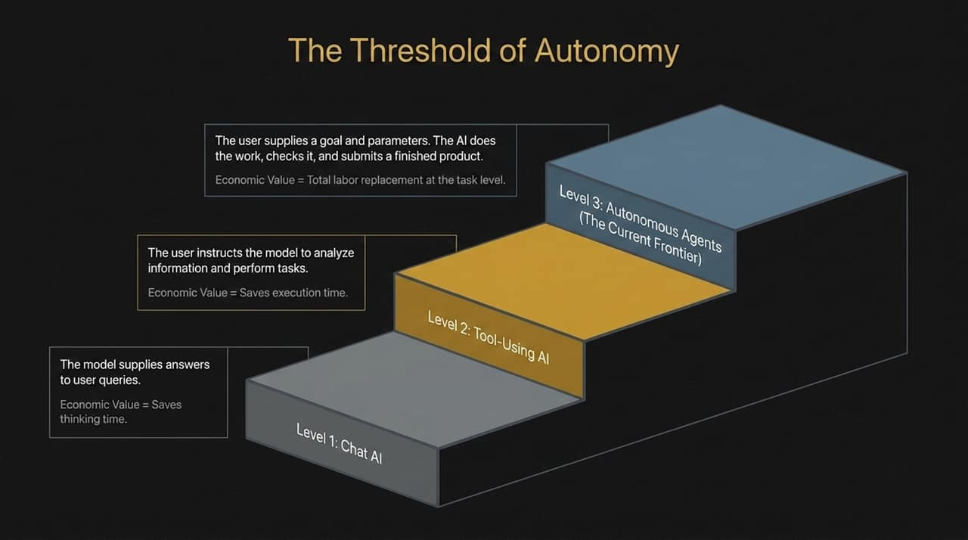
Notes:
Level 1 — Chat AI:
Informational Q&A (e.g., standard ChatGPT or Claude queries).
Value: Saves baseline research and thinking time.
Level 2 — Tool-Using AI:
The user instructs the model to execute specific workflows (e.g., search databases, run Python scripts, extract financial tables).
Value: Saves execution time, but requires continuous user direction.
Level 3 — Autonomous Agents (The Current Frontier):
The user defines the objective and constraints; the AI executes the multi-step task, tests its own work, and delivers a completed project.
Economic Value Shift: Level 1 and 2 assist labor; Level 3 replaces labor at the task level.

Slide 7
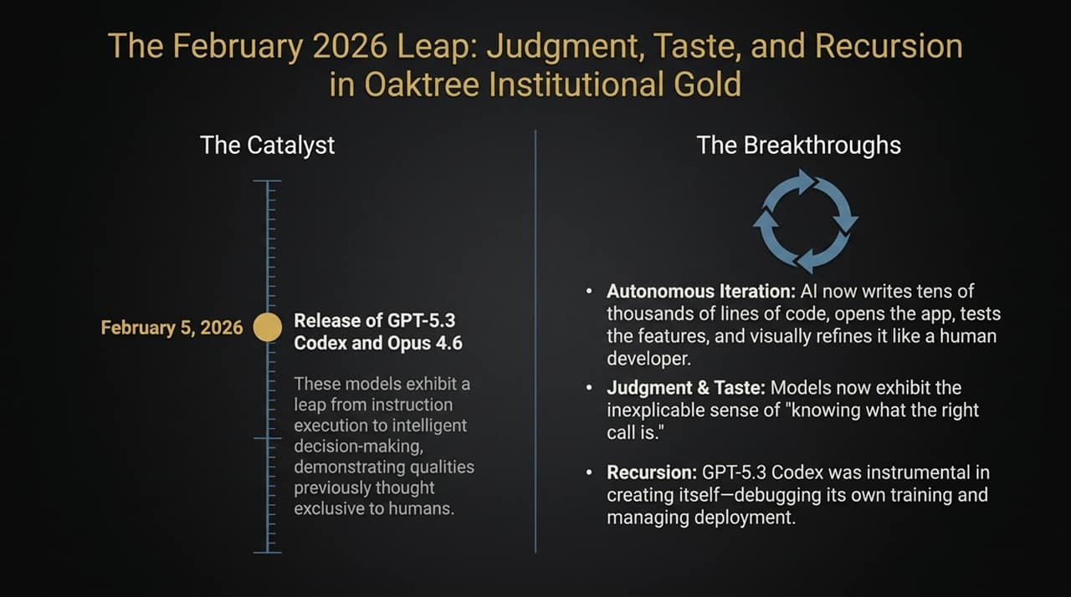
Notes:
The Catalyst (February 2026):
Models like GPT-5.3 Codex and Opus 4.6 represented a step-function jump from instruction-following to autonomous decision-making.
Three Key Breakthroughs:
Autonomous Iteration: AI now writes tens of thousands of lines of code, spins up environments, tests features visually, and fixes bugs without human oversight.
Judgment & Taste: Models display an implicit sense of design, tone, and strategic nuance ("knowing what the right call is").
Recursion: AI models are now actively participating in building, debugging, and deploying their own next-generation architectures.

Slide 8
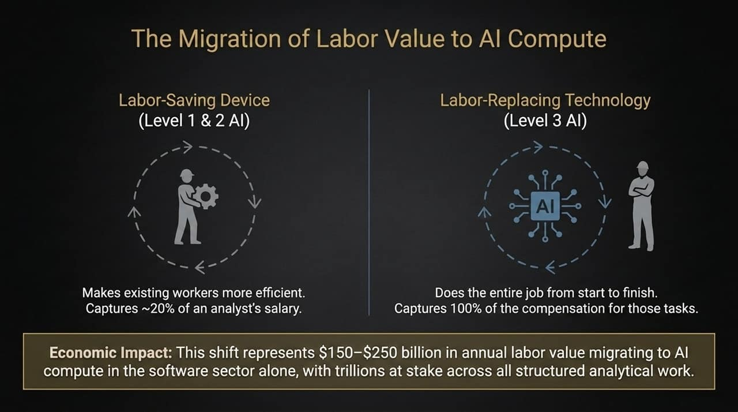
Notes:
From Efficiency to Substitution:
Level 1/2 tools make an analyst 20% more efficient, allowing firms to capture minor margin improvements.
Level 3 autonomous agents replace entire multi-step workflows, shifting 100% of the labor cost assigned to those tasks directly to AI compute infrastructure.
The Macro Numbers:
In software development and financial services alone, this represents $150–$250 billion in annual labor compensation migrating directly into AI compute spend.
Globally, trillions of dollars in white-collar analytical payroll are exposed to this shift.

Slide 9
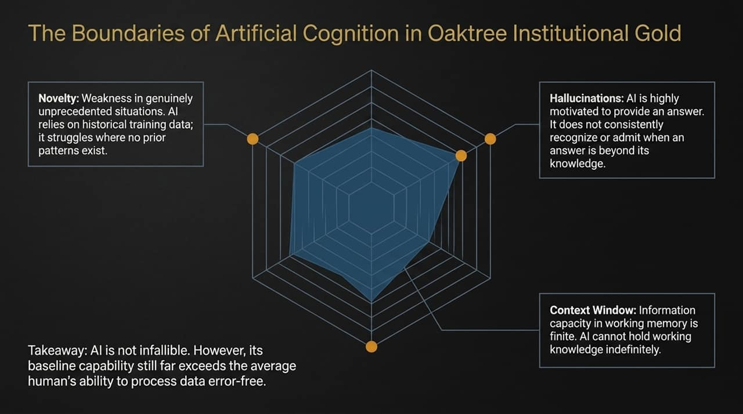
Notes:
Where AI Struggles:
Novelty: AI relies on historical training patterns. In unprecedented economic crises or black-swan events, it lacks empirical precedent to guide decisions.
Hallucinations: Models are trained to provide answers and may assert false conclusions rather than easily admit ignorance.
Context Window Limits: Working memory remains finite.
The Balanced Reality:
While AI is not infallible, its baseline processing accuracy, speed, and memory far exceed the average human's data-handling capacity.

Slide 10
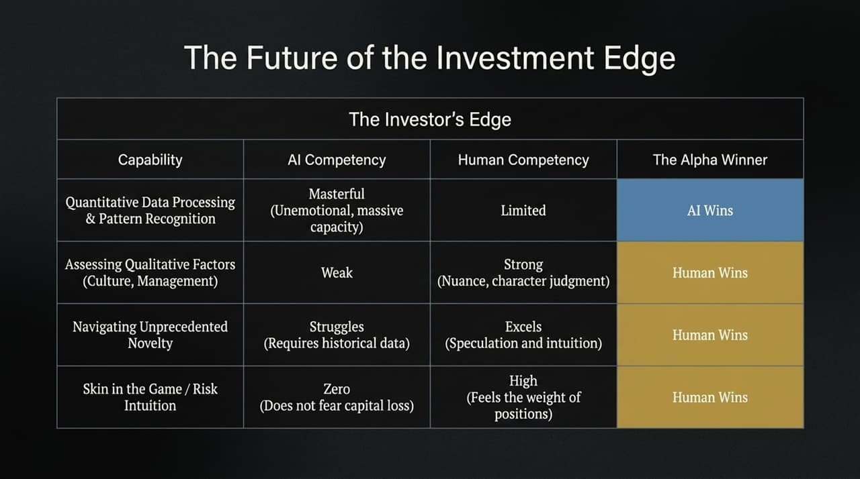
Notes:
AI's Domain (Quant & Patterns):
Quantitative processing, data aggregation, and objective pattern recognition belong entirely to AI. It operates without fear, greed, or fatigue.
Human Domain (Qualitative & Risk):
Qualitative Factors: Assessing management integrity, corporate culture, and strategic adaptability.
Unprecedented Scenarios: Navigating novel, high-uncertainty market regimes.
Skin in the Game: AI feels no psychological pressure or fear of capital loss. Human investors bear real responsibility for downside risk.

Slide 11
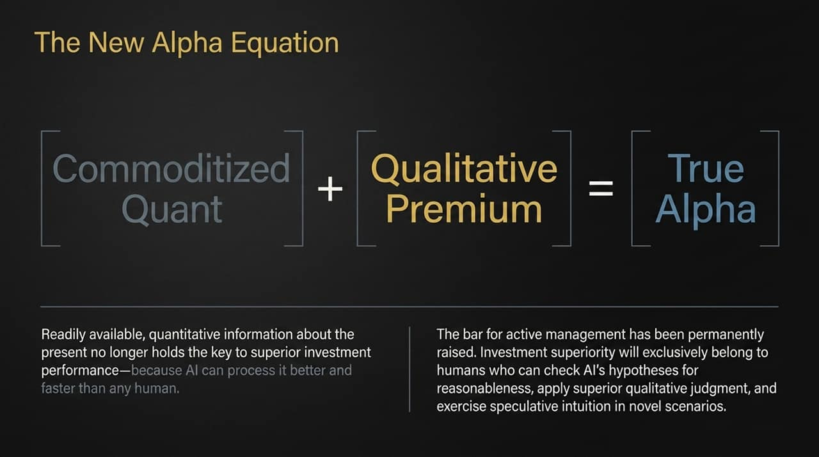
Notes:
The Formula:
Commoditized Quant + Qualitative Premium = True Alpha
Death of Traditional Quant Advantage:
Relying solely on historical financial models or fast data processing no longer generates excess returns. AI commoditizes public information analysis instantly.
Raising the Active Management Bar:
Outperformance now requires checking AI's hypotheses for sanity, probing qualitative management claims, and exercising intuitive judgment when data is incomplete.

Slide 12
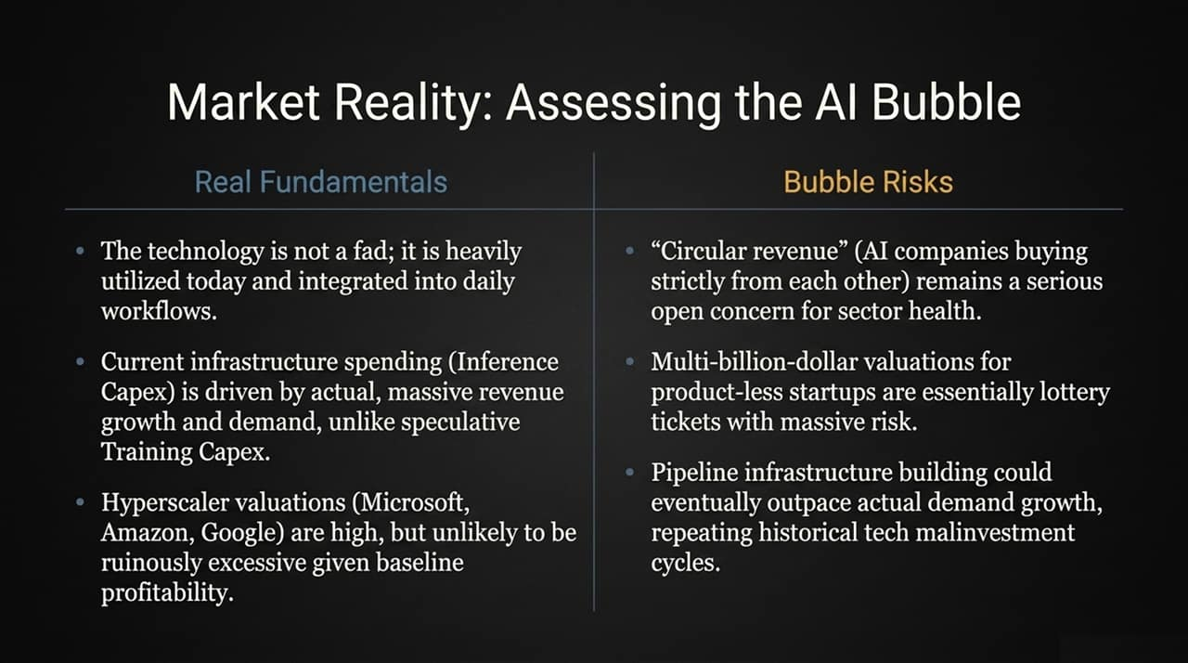
Notes:
Real Fundamentals (Why it's not purely a bubble):
High enterprise adoption and real revenue generation. Capital spending is driven by immediate inference demand, supported by massive cash flows from tech hyperscalers.
Bubble Risks (Where caution is needed):
Circular Revenue: AI companies funding AI startups that spend cash buying compute back from the parent firm.
Pre-Product Valuations: Startup valuations pricing in flawless execution.
Infrastructure Overshoot: Buildouts occasionally outpacing near-term demand software cycles.

Slide 13
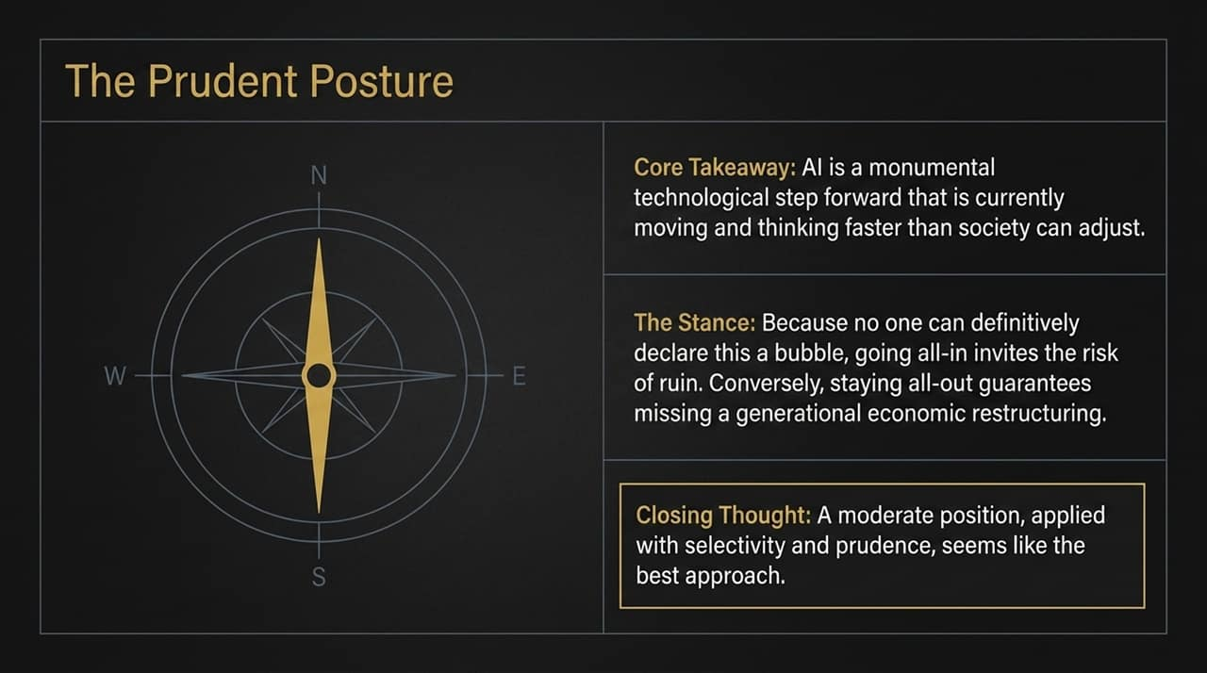
Notes:
The Core Dilemma:
AI is an accelerating technological wave moving faster than institutional adaptation.
Managing Portfolio Risk:
Going All-In: Risks severe capital loss if valuation multiples compress or infrastructure spending overshoots.
Staying All-Out: Guarantees missing out on a generational restructuring of productivity and wealth creation.
Conclusion: Adopt a disciplined, selective posture—investing in durable, cash-flow-backed AI enablers while avoiding unproven, hype-driven software valuations.

Slide 14
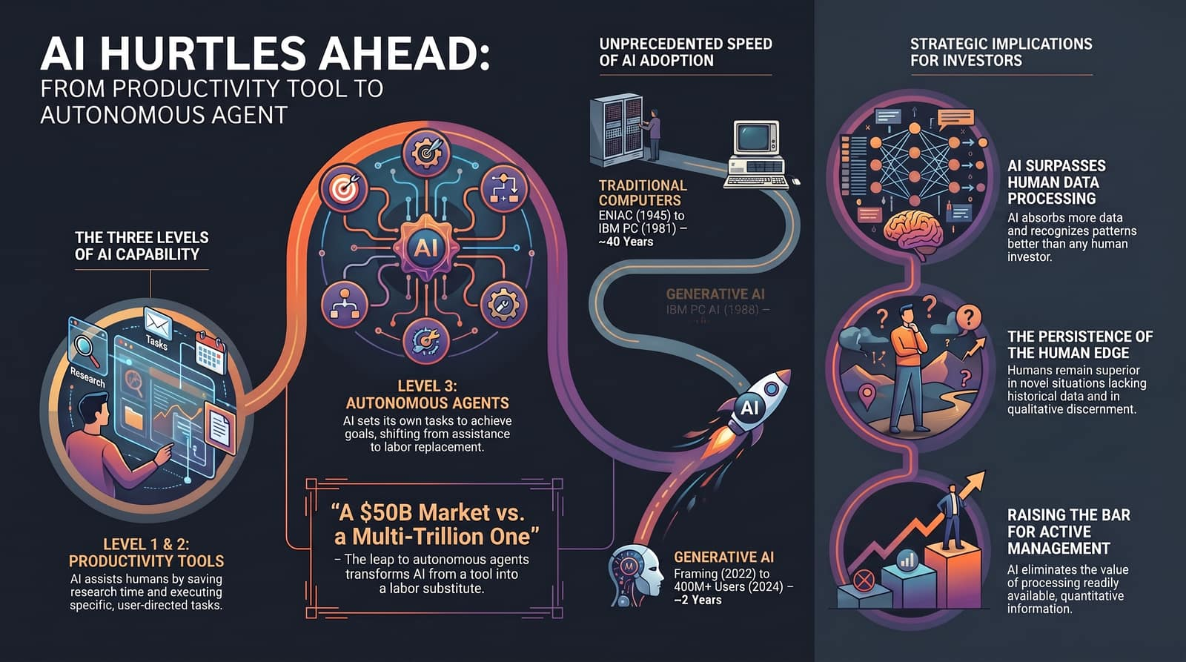
Notes:
Summary of Strategic Implications:
Level 3 Shift: Autonomous agents shift AI from a productivity helper to direct labor substitution.
Adoption Rate: Adoption speed is unprecedented compared to traditional IT cycles.
Investment Alpha: Fundamental analysis is moving away from quantitative data crunching toward qualitative evaluation and handling unprecedented situations.
Final Closing Thought: Focus on where human judgment creates value alongside machine intelligence rather than trying to compete on raw processing power.

